Slide 1
COMP4901K/Math4824B Machine Learning for Natural Language Processing
Lecture 2: Introduction to NLP
Instructor: Yangqiu Song

Slide 2
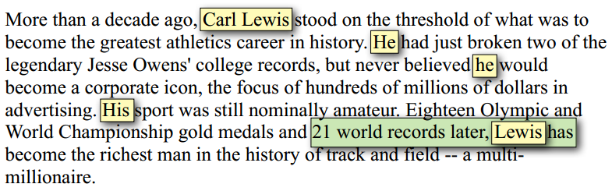
Towards understanding of text
Who is Carl Lewis?
Did Carl Lewis break any records?

Slide 3
What is NLP?
Arabic text
كلب هو مطاردة صبي في الملعب.
How can a computer make sense out of this string?
- What are the basic units of meaning (words)?
- What is the meaning of each word?
Morphology
Syntax
- How are words related with each other?
Semantics
- What is the “combined meaning” of words?
Pragmatics
- What is the “meta-meaning”? (speech act)
Discourse
- Handling a large chunk of text
Inference
- Making sense of everything

Slide 4



If we can do this for all the sentences in all languages, then …
Automatically answer our emails
Translate languages accurately
Help us manage, summarize, and aggregate information
Use speech as a UI (when needed)
Talk to us / listen to us
BAD NEWS:
Unfortunately, we cannot right now.
General NLP = “Complete AI”

Slide 5
A brief history of NLP
Early enthusiasm (1950’s): Machine Translation
Too ambitious
Bar-Hillel report (1960) concluded that fully-automatic high-quality translation could not be accomplished without knowledge (Dictionary + Encyclopedia)
Less ambitious applications (late 1960’s & early 1970’s): Limited success, failed to scale up
Speech recognition
Dialogue (Eliza)
Inference and domain knowledge (SHRDLU=“block world”)
Real world evaluation (late 1970’s – now)
Story understanding (late 1970’s & early 1980’s)
Large scale evaluation of speech recognition, text retrieval, information extraction (1980 – now)
Statistical approaches enjoy more success (first in speech recognition & retrieval, later others)
Current trend:
Boundary between statistical and symbolic approaches is disappearing.
We need to use all the available knowledge
Application-driven NLP research (bioinformatics, Web, Question answering…)
Deep understanding in
limited domain
Shallow understanding
Knowledge representation
Robust component techniques
Statistical language models
A lot of applications nowadays

Slide 6
NLP is difficult!!!!!!!
Natural language is designed to make human communication efficient. Therefore,
We omit a lot of “common sense” knowledge, which we assume the hearer/reader possesses
We keep a lot of ambiguities, which we assume the hearer/reader knows how to resolve
This makes EVERY step in NLP hard
Ambiguity is a “killer”!
Common sense reasoning is pre-required

Slide 7
Variability and ambiguity
cat
company
fruit
tree
Meaning
Variability
Ambiguity
Language
cat
feline
kitty
moggy
apple

Slide 8
Levels of Linguistic Analysis
Pragmatics: what does it do?
implemented the
right algorithm
Semantics: what does it mean?
no implementation bugs
Syntax: what is grammatical?
no compiler errors
Morphology: basic unit of words
naming your world

Slide 9
Analogy with Programming Languages
Syntax: no compiler errors
Semantics: no implementation bugs
Pragmatics: implemented the right algorithm
Different syntax, same semantics (5):
2 + 3 <-> 3 + 2
Good semantics, bad pragmatics:
correct implementation of deep neural network
for estimating coin flip prob.

Slide 10
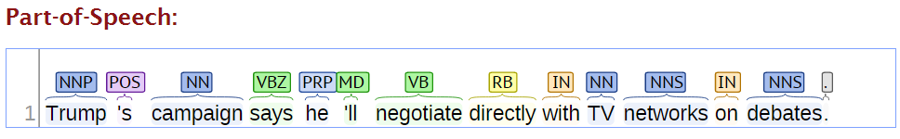
Syntax (1)
Part of speech
Tags:
NN: common noun
NNP: proper noun
VB: verb, base form
VBZ: verb, 3rd person singular
…

Slide 11
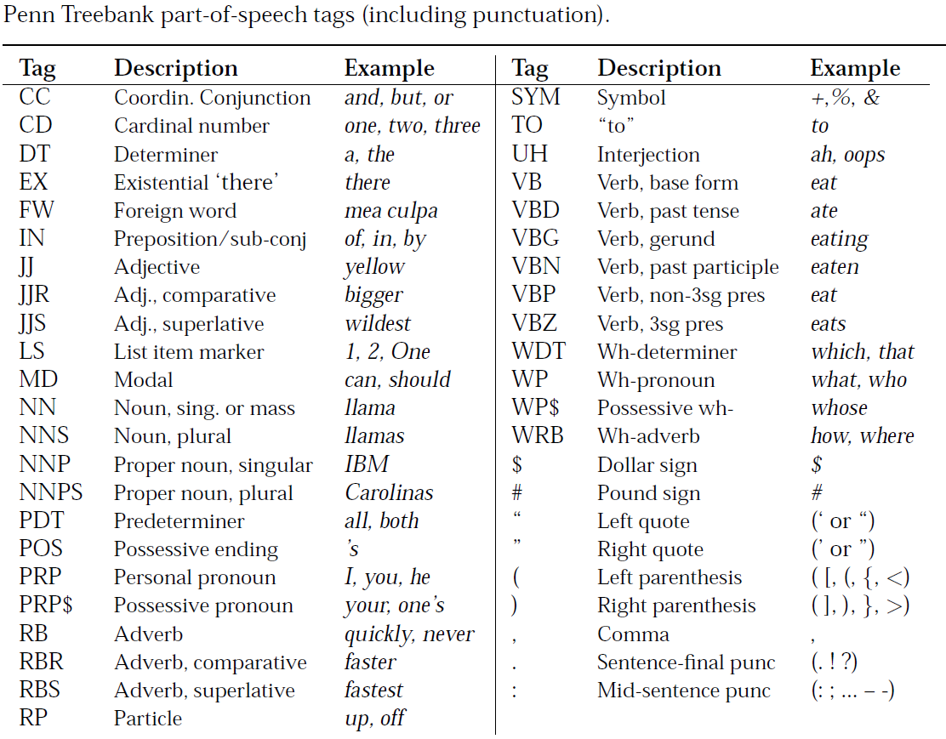
Notes:
POS: possessive ending
PRP: personal pronoun
MD: modal, can, should

Slide 12
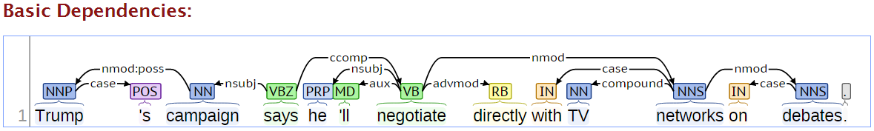
Syntax (2)
Dependency parse
Dependency relations:
nsubj: subject (nominal)
advmod: adverbial modifier

Slide 13
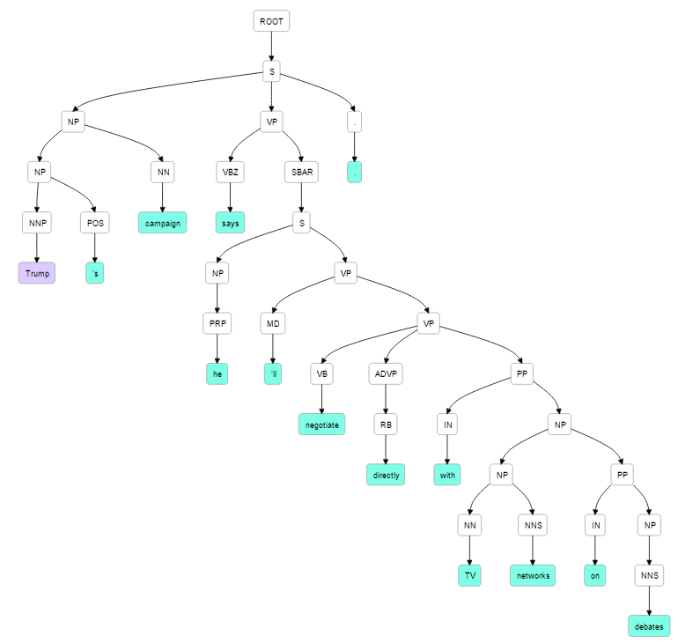
Syntax (3)
Constituency parsing (成分句法分析)

Slide 14
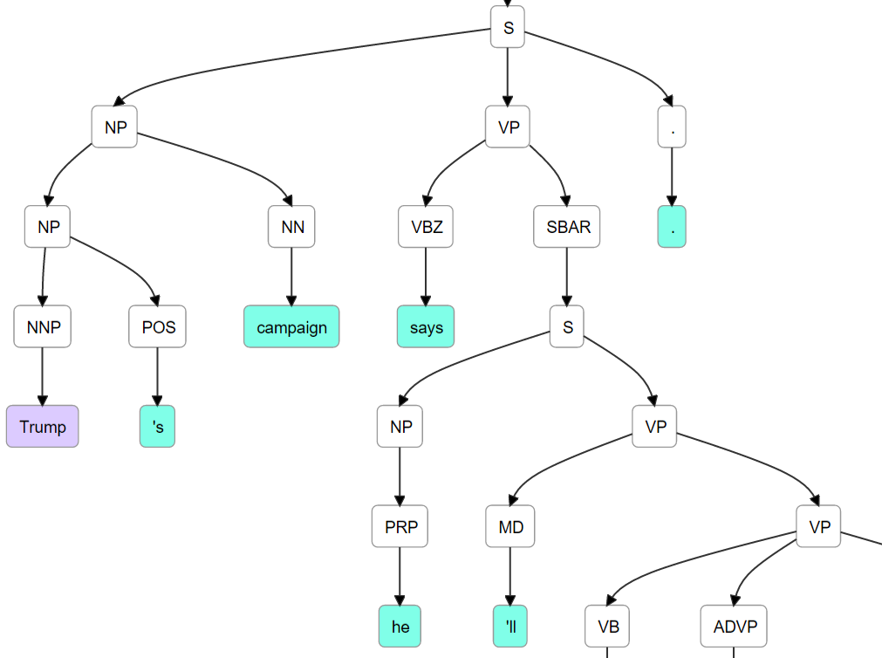
POS: possessive ending
PRP: personal pronoun
MD: modal; can, should

Slide 15
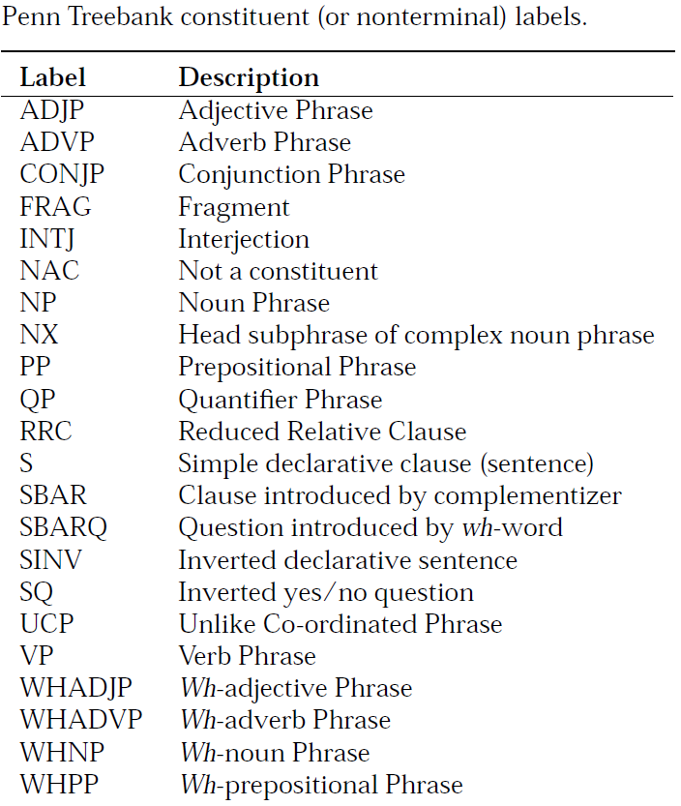

Slide 16
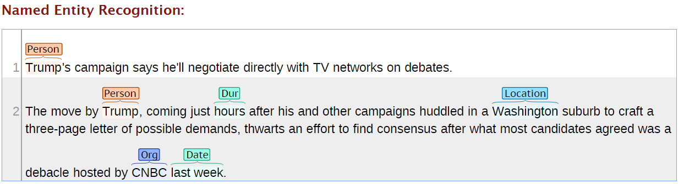
Semantic (1)
Named entities
Pers: Person
Location
Org: Organization
Date/time
…

Slide 17
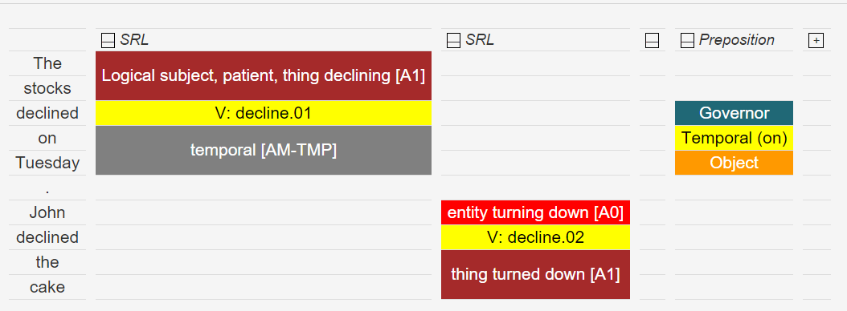
Semantics (2)
Frame based semantics
Cynthia sold the bike to Bob for $200
SELLER PREDICATE GOODS BUYER PRICE
Semantic role labeling (SRL)

Slide 18
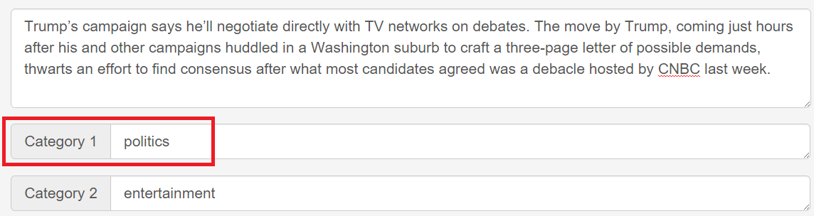
Semantic (3)
Topics
Categorization/classification
Clustering
Topic modeling

Slide 19
Semantics (4) Lexical/Compositional Semantics
Word
Multi-word expressions: meaning unit beyond a word
Morphology: meaning unit within a word
Polysemy: one word has multiple meanings (word senses)
Synonymy/paraphrasing
light
light bulb
light lighten lightening relight
The light was filtered through a soft glass window.
He stepped into the light.
confusing and unclear
I have fond memories of my childhood.
I reflect on my childhood with a certain fondness.
I enjoy thinking back to when I was a kid.

Slide 20
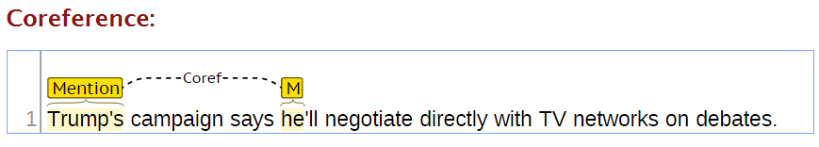
Discourse (对话、交流)
Coreference
The dog chased the cat, which ran up a tree. It waited at the top.
The dog chased the cat, which ran up a tree. It waited at the bottom.
Paul tried to call George on the phone, but he wasn’t successful.
Paul tried to call George on the phone, but he wasn’t available.
Discourse: sentence relation
S1: Senator calls this “the first gift of democracy”.
S2: The Poles might do better to view this as a Trojan Horse.
But
Contrast relationship

Slide 21
Pragmatics (语用学)
Semantics: what does it mean literally?
Pragmatics: what is the speaker really conveying?
Conversational implicature
A: What on earth has happened to the roast beef?
B: The dog is looking very happy.
Implicature: The dog at the roast beef.
Presupposition: background assumption independent of truth of sentence
I have stopped eating meat.
Presupposition: I once was eating meat.

Slide 22
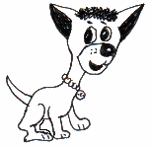
An example of NLP
A dog is chasing a boy on the playground.
Det
Noun
Aux
Verb
Det
Noun
Prep
Det
Noun
Lexical
analysis
(part-of-speech
tagging)
Noun Phrase
Noun Phrase
Complex Verb
Noun Phrase
Semantic analysis
Prep Phrase
Dog(d1).
Boy(b1).
Playground(p1).
Chasing(d1,b1,p1).
Verb Phrase
Syntactic analysis
(Parsing)
Verb Phrase
+
Sentence
Scared(x) if Chasing(_,x,_).
A person saying this may
be reminding another person to get the dog back…
Scared(b1)
Inference
Pragmatic analysis
(speech act)

Slide 23
The state of the art
A dog is chasing a boy on the playground
POS
Tagging:
97%
Det
Noun
Aux
Verb
Det
Noun
Prep
Det
Noun
Noun Phrase
Noun Phrase
Complex Verb
Noun Phrase
Prep Phrase
Verb Phrase
Parsing: partial >90%
Semantics: some aspects
Entity/relation extraction
Word sense disambiguation
Anaphora resolution
Verb Phrase
Sentence
Inference: ???
Speech act analysis: ???

Slide 24
More about “Commonsense Knowledge”
When we communicate,
we omit a lot of “common sense” knowledge, which we assume the hearer/reader possesses
we keep a lot of ambiguities, which we assume the hearer/reader knows how to resolve

Slide 25
What is Commonsense Knowledge?
Knowledge about the everyday world that is possessed by all people
A lemon is sour.
To open a door, you must usually first turn the doorknob.
If you forget someone’s birthday, they may be unhappy with you.

Slide 26
More Examples
A coat is used for keeping warm.
People want to be respected.
The sun is very hot.
The last thing you do when you cook dinner is wash your dishes.
People want good coffee.

Slide 27
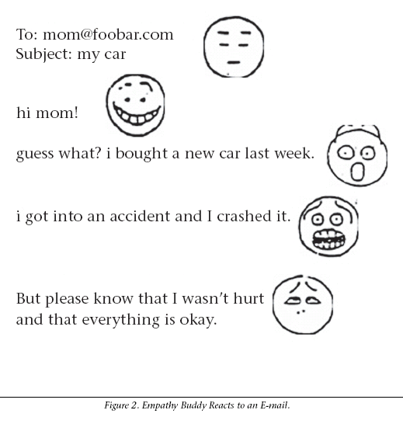
Detecting Moods (“affect”) in Text
“My wife left me; she took the kids and the dog”
⇒ ☹
Approach:
Mood keyword (e.g., “sad”) → mine a “small society of linguistic models of effect” from the KB (=?)
Applications:
Summarizing a collection of reviews about a topic

Slide 28
Machine Translation
The classic acid test for natural language processing.
Requires capabilities in both interpretation and generation.
About $33 billion spent annually on human translation!

Slide 29
Statistical Solution
Parallel Texts
Rosetta Stone
Hieroglyphs
Demotic
Greek

Slide 30
Statistical Solution
Parallel Texts
Instruction Manuals
Hong Kong/Macao Legislation
United Nations Reports
Official Journal of the European Communities
Translated news

Slide 31
A Practice for You: Translation Exercise: Learning to translate using parallel text
Centauri/Arcturan [Knight, 1997]
Your assignment, translate this to Arcturan:
farok crrrok hihok yorok clok kantok ok-yurp

Slide 32
Centauri/Arcturan [Knight, 1997]
Your assignment, translate this to Arcturan: farok crrrok hihok yorok clok kantok ok-yurp
1a. ok-voon ororok sprok .
1b. at-voon bichat dat .
7a. lalok farok ororok lalok sprok izok enemok .
7b. wat jjat bichat wat dat vat eneat .
2a. ok-drubel ok-voon anok plok sprok .
2b. at-drubel at-voon pippat rrat dat .
8a. lalok brok anok plok nok .
8b. iat lat pippat rrat nnat .
3a. erok sprok izok hihok ghirok .
3b. totat dat arrat vat hilat .
9a. wiwok nok izok kantok ok-yurp .
9b. totat nnat quat oloat at-yurp .
4a. ok-voon anok drok brok jok .
4b. at-voon krat pippat sat lat .
10a. lalok mok nok yorok ghirok clok .
10b. wat nnat gat mat bat hilat .
5a. wiwok farok izok stok .
5b. totat jjat quat cat .
11a. lalok nok crrrok hihok yorok zanzanok .
11b. wat nnat arrat mat zanzanat .
6a. lalok sprok izok jok stok .
6b. wat dat krat quat cat .
12a. lalok rarok nok izok hihok mok .
12b. wat nnat forat arrat vat gat .
Slide from Kevin Knight

Slide 33
Centauri/Arcturan [Knight, 1997]
Your assignment, translate this to Arcturan: farok crrrok hihok yorok clok kantok ok-yurp
1a. ok-voon ororok sprok .
1b. at-voon bichat dat .
7a. lalok farok ororok lalok sprok izok enemok .
7b. wat jjat bichat wat dat vat eneat .
2a. ok-drubel ok-voon anok plok sprok .
2b. at-drubel at-voon pippat rrat dat .
8a. lalok brok anok plok nok .
8b. iat lat pippat rrat nnat .
3a. erok sprok izok hihok ghirok .
3b. totat dat arrat vat hilat .
9a. wiwok nok izok kantok ok-yurp .
9b. totat nnat quat oloat at-yurp .
4a. ok-voon anok drok brok jok .
4b. at-voon krat pippat sat lat .
10a. lalok mok nok yorok ghirok clok .
10b. wat nnat gat mat bat hilat .
5a. wiwok farok izok stok .
5b. totat jjat quat cat .
11a. lalok nok crrrok hihok yorok zanzanok .
11b. wat nnat arrat mat zanzanat .
6a. lalok sprok izok jok stok .
6b. wat dat krat quat cat .
12a. lalok rarok nok izok hihok mok .
12b. wat nnat forat arrat vat gat .

Slide 34
Centauri/Arcturan [Knight, 1997]
Your assignment, translate this to Arcturan: farok crrrok hihok yorok clok kantok ok-yurp
1a. ok-voon ororok sprok .
1b. at-voon bichat dat .
7a. lalok farok ororok lalok sprok izok enemok .
7b. wat jjat bichat wat dat vat eneat .
2a. ok-drubel ok-voon anok plok sprok .
2b. at-drubel at-voon pippat rrat dat .
8a. lalok brok anok plok nok .
8b. iat lat pippat rrat nnat .
3a. erok sprok izok hihok ghirok .
3b. totat dat arrat vat hilat .
9a. wiwok nok izok kantok ok-yurp .
9b. totat nnat quat oloat at-yurp .
4a. ok-voon anok drok brok jok .
4b. at-voon krat pippat sat lat .
10a. lalok mok nok yorok ghirok clok .
10b. wat nnat gat mat bat hilat .
5a. wiwok farok izok stok .
5b. totat jjat quat cat .
11a. lalok nok crrrok hihok yorok zanzanok .
11b. wat nnat arrat mat zanzanat .
6a. lalok sprok izok jok stok .
6b. wat dat krat quat cat .
12a. lalok rarok nok izok hihok mok .
12b. wat nnat forat arrat vat gat .

Slide 35
Centauri/Arcturan [Knight, 1997]
Your assignment, translate this to Arcturan: farok crrrok hihok yorok clok kantok ok-yurp
1a. ok-voon ororok sprok .
1b. at-voon bichat dat .
7a. lalok farok ororok lalok sprok izok enemok .
7b. wat jjat bichat wat dat vat eneat .
2a. ok-drubel ok-voon anok plok sprok .
2b. at-drubel at-voon pippat rrat dat .
8a. lalok brok anok plok nok .
8b. iat lat pippat rrat nnat .
3a. erok sprok izok hihok ghirok .
3b. totat dat arrat vat hilat .
9a. wiwok nok izok kantok ok-yurp .
9b. totat nnat quat oloat at-yurp .
4a. ok-voon anok drok brok jok .
4b. at-voon krat pippat sat lat .
10a. lalok mok nok yorok ghirok clok .
10b. wat nnat gat mat bat hilat .
5a. wiwok farok izok stok .
5b. totat jjat quat cat .
11a. lalok nok crrrok hihok yorok zanzanok .
11b. wat nnat arrat mat zanzanat .
???
6a. lalok sprok izok jok stok .
6b. wat dat krat quat cat .
12a. lalok rarok nok izok hihok mok .
12b. wat nnat forat arrat vat gat .

Slide 36
Centauri/Arcturan [Knight, 1997]
Your assignment, translate this to Arcturan: farok crrrok hihok yorok clok kantok ok-yurp
1a. ok-voon ororok sprok .
1b. at-voon bichat dat .
7a. lalok farok ororok lalok sprok izok enemok .
7b. wat jjat bichat wat dat vat eneat .
2a. ok-drubel ok-voon anok plok sprok .
2b. at-drubel at-voon pippat rrat dat .
8a. lalok brok anok plok nok .
8b. iat lat pippat rrat nnat .
3a. erok sprok izok hihok ghirok .
3b. totat dat arrat vat hilat .
9a. wiwok nok izok kantok ok-yurp .
9b. totat nnat quat oloat at-yurp .
4a. ok-voon anok drok brok jok .
4b. at-voon krat pippat sat lat .
10a. lalok mok nok yorok ghirok clok .
10b. wat nnat gat mat bat hilat .
5a. wiwok farok izok stok .
5b. totat jjat quat cat .
11a. lalok nok crrrok hihok yorok zanzanok .
11b. wat nnat arrat mat zanzanat .
6a. lalok sprok izok jok stok .
6b. wat dat krat quat cat .
12a. lalok rarok nok izok hihok mok .
12b. wat nnat forat arrat vat gat .

Slide 37
Centauri/Arcturan [Knight, 1997]
Your assignment, translate this to Arcturan: farok crrrok hihok yorok clok kantok ok-yurp
1a. ok-voon ororok sprok .
1b. at-voon bichat dat .
7a. lalok farok ororok lalok sprok izok enemok .
7b. wat jjat bichat wat dat vat eneat .
2a. ok-drubel ok-voon anok plok sprok .
2b. at-drubel at-voon pippat rrat dat .
8a. lalok brok anok plok nok .
8b. iat lat pippat rrat nnat .
3a. erok sprok izok hihok ghirok .
3b. totat dat arrat vat hilat .
9a. wiwok nok izok kantok ok-yurp .
9b. totat nnat quat oloat at-yurp .
4a. ok-voon anok drok brok jok .
4b. at-voon krat pippat sat lat .
10a. lalok mok nok yorok ghirok clok .
10b. wat nnat gat mat bat hilat .
5a. wiwok farok izok stok .
5b. totat jjat quat cat .
11a. lalok nok crrrok hihok yorok zanzanok .
11b. wat nnat arrat mat zanzanat .
6a. lalok sprok izok jok stok .
6b. wat dat krat quat cat .
12a. lalok rarok nok izok hihok mok .
12b. wat nnat forat arrat vat gat .

Slide 38
Centauri/Arcturan [Knight, 1997]
Your assignment, translate this to Arcturan: farok crrrok hihok yorok clok kantok ok-yurp
1a. ok-voon ororok sprok .
1b. at-voon bichat dat .
7a. lalok farok ororok lalok sprok izok enemok .
7b. wat jjat bichat wat dat vat eneat .
2a. ok-drubel ok-voon anok plok sprok .
2b. at-drubel at-voon pippat rrat dat .
8a. lalok brok anok plok nok .
8b. iat lat pippat rrat nnat .
3a. erok sprok izok hihok ghirok .
3b. totat dat arrat vat hilat .
9a. wiwok nok izok kantok ok-yurp .
9b. totat nnat quat oloat at-yurp .
4a. ok-voon anok drok brok jok .
4b. at-voon krat pippat sat lat .
10a. lalok mok nok yorok ghirok clok .
10b. wat nnat gat mat bat hilat .
5a. wiwok farok izok stok .
5b. totat jjat quat cat .
11a. lalok nok crrrok hihok yorok zanzanok .
11b. wat nnat arrat mat zanzanat .
6a. lalok sprok izok jok stok .
6b. wat dat krat quat cat .
12a. lalok rarok nok izok hihok mok .
12b. wat nnat forat arrat vat gat .

Slide 39
Centauri/Arcturan [Knight, 1997]
Your assignment, translate this to Arcturan: farok crrrok hihok yorok clok kantok ok-yurp
1a. ok-voon ororok sprok .
1b. at-voon bichat dat .
7a. lalok farok ororok lalok sprok izok enemok .
7b. wat jjat bichat wat dat vat eneat .
2a. ok-drubel ok-voon anok plok sprok .
2b. at-drubel at-voon pippat rrat dat .
8a. lalok brok anok plok nok .
8b. iat lat pippat rrat nnat .
3a. erok sprok izok hihok ghirok .
3b. totat dat arrat vat hilat .
9a. wiwok nok izok kantok ok-yurp .
9b. totat nnat quat oloat at-yurp .
4a. ok-voon anok drok brok jok .
4b. at-voon krat pippat sat lat .
10a. lalok mok nok yorok ghirok clok .
10b. wat nnat gat mat bat hilat .
???
5a. wiwok farok izok stok .
5b. totat jjat quat cat .
11a. lalok nok crrrok hihok yorok zanzanok .
11b. wat nnat arrat mat zanzanat .
6a. lalok sprok izok jok stok .
6b. wat dat krat quat cat .
12a. lalok rarok nok izok hihok mok .
12b. wat nnat forat arrat vat gat .

Slide 40
Centauri/Arcturan [Knight, 1997]
Your assignment, translate this to Arcturan: farok crrrok hihok yorok clok kantok ok-yurp
1a. ok-voon ororok sprok .
1b. at-voon bichat dat .
7a. lalok farok ororok lalok sprok izok enemok .
7b. wat jjat bichat wat dat vat eneat .
2a. ok-drubel ok-voon anok plok sprok .
2b. at-drubel at-voon pippat rrat dat .
8a. lalok brok anok plok nok .
8b. iat lat pippat rrat nnat .
3a. erok sprok izok hihok ghirok .
3b. totat dat arrat vat hilat .
9a. wiwok nok izok kantok ok-yurp .
9b. totat nnat quat oloat at-yurp .
4a. ok-voon anok drok brok jok .
4b. at-voon krat pippat sat lat .
10a. lalok mok nok yorok ghirok clok .
10b. wat nnat gat mat bat hilat .
5a. wiwok farok izok stok .
5b. totat jjat quat cat .
11a. lalok nok crrrok hihok yorok zanzanok .
11b. wat nnat arrat mat zanzanat .
6a. lalok sprok izok jok stok .
6b. wat dat krat quat cat .
12a. lalok rarok nok izok hihok mok .
12b. wat nnat forat arrat vat gat .

Slide 41
Centauri/Arcturan [Knight, 1997]
Your assignment, translate this to Arcturan: farok crrrok hihok yorok clok kantok ok-yurp
1a. ok-voon ororok sprok .
1b. at-voon bichat dat .
7a. lalok farok ororok lalok sprok izok enemok .
7b. wat jjat bichat wat dat vat eneat .
2a. ok-drubel ok-voon anok plok sprok .
2b. at-drubel at-voon pippat rrat dat .
8a. lalok brok anok plok nok .
8b. iat lat pippat rrat nnat .
3a. erok sprok izok hihok ghirok .
3b. totat dat arrat vat hilat .
9a. wiwok nok izok kantok ok-yurp .
9b. totat nnat quat oloat at-yurp .
4a. ok-voon anok drok brok jok .
4b. at-voon krat pippat sat lat .
10a. lalok mok nok yorok ghirok clok .
10b. wat nnat gat mat bat hilat .
process of
elimination
5a. wiwok farok izok stok .
5b. totat jjat quat cat .
11a. lalok nok crrrok hihok yorok zanzanok .
11b. wat nnat arrat mat zanzanat .
6a. lalok sprok izok jok stok .
6b. wat dat krat quat cat .
12a. lalok rarok nok izok hihok mok .
12b. wat nnat forat arrat vat gat .

Slide 42
Centauri/Arcturan [Knight, 1997]
Your assignment, translate this to Arcturan: farok crrrok hihok yorok clok kantok ok-yurp
1a. ok-voon ororok sprok .
1b. at-voon bichat dat .
7a. lalok farok ororok lalok sprok izok enemok .
7b. wat jjat bichat wat dat vat eneat .
2a. ok-drubel ok-voon anok plok sprok .
2b. at-drubel at-voon pippat rrat dat .
8a. lalok brok anok plok nok .
8b. iat lat pippat rrat nnat .
3a. erok sprok izok hihok ghirok .
3b. totat dat arrat vat hilat .
9a. wiwok nok izok kantok ok-yurp .
9b. totat nnat quat oloat at-yurp .
4a. ok-voon anok drok brok jok .
4b. at-voon krat pippat sat lat .
10a. lalok mok nok yorok ghirok clok .
10b. wat nnat gat mat bat hilat .
5a. wiwok farok izok stok .
5b. totat jjat quat cat .
11a. lalok nok crrrok hihok yorok zanzanok .
11b. wat nnat arrat mat zanzanat .
cognate?
6a. lalok sprok izok jok stok .
6b. wat dat krat quat cat .
12a. lalok rarok nok izok hihok mok .
12b. wat nnat forat arrat vat gat .

Slide 43
Centauri/Arcturan [Knight, 1997]
Your assignment, put these words in order: { jjat, arrat, mat, bat, oloat, at-yurp }
1a. ok-voon ororok sprok .
1b. at-voon bichat dat .
7a. lalok farok ororok lalok sprok izok enemok .
7b. wat jjat bichat wat dat vat eneat .
2a. ok-drubel ok-voon anok plok sprok .
2b. at-drubel at-voon pippat rrat dat .
8a. lalok brok anok plok nok .
8b. iat lat pippat rrat nnat .
3a. erok sprok izok hihok ghirok .
3b. totat dat arrat vat hilat .
9a. wiwok nok izok kantok ok-yurp .
9b. totat nnat quat oloat at-yurp .
4a. ok-voon anok drok brok jok .
4b. at-voon krat pippat sat lat .
10a. lalok mok nok yorok ghirok clok .
10b. wat nnat gat mat bat hilat .
5a. wiwok farok izok stok .
5b. totat jjat quat cat .
11a. lalok nok crrrok hihok yorok zanzanok .
11b. wat nnat arrat mat zanzanat .
zero
fertility
6a. lalok sprok izok jok stok .
6b. wat dat krat quat cat .
12a. lalok rarok nok izok hihok mok .
12b. wat nnat forat arrat vat gat .

Slide 44
It’s Really Spanish/English
Clients do not sell pharmaceuticals in Europe => Clientes no venden medicinas en Europa
1a. Garcia and associates .
1b. Garcia y asociados .
7a. the clients and the associates are enemies .
7b. los clients y los asociados son enemigos .
2a. Carlos Garcia has three associates .
2b. Carlos Garcia tiene tres asociados .
8a. the company has three groups .
8b. la empresa tiene tres grupos .
3a. his associates are not strong .
3b. sus asociados no son fuertes .
9a. its groups are in Europe .
9b. sus grupos estan en Europa .
4a. Garcia has a company also .
4b. Garcia tambien tiene una empresa .
10a. the modern groups sell strong pharmaceuticals .
10b. los grupos modernos venden medicinas fuertes .
5a. its clients are angry .
5b. sus clientes estan enfadados .
11a. the groups do not sell zenzanine .
11b. los grupos no venden zanzanina .
6a. the associates are also angry .
6b. los asociados tambien estan enfadados .
12a. the small groups are not modern .
12b. los grupos pequenos no son modernos .
Slide from Kevin Knight

Slide 45
Statistical Learning to MT?
Traditional SMT did a lot of alignment like this
It’s actually a learning+inference process
Learning: learning the parameters to fit the data
Inference: make decisions online for the alignment with large likelihood and constraints (rules defined by human)
Deep learning
Much simplified the process
Sequence to sequence model, which we will see
Can we borrow the ideas for deep learning?
Still an active research area

Slide 46
Goal of this Lecture
Get familiar with some of the NLP terminologies and tasks
We won’t be able to touch all of the tasks
But we will use some of the terminologies (will also re-introduce when needed)
Modern NLP solutions are based on large scale annotations
Then the problem becomes machine learning
how to (over-)fit the data
A detour: there is still a lot of problem
We will focus on machine learning algorithms that can handle text data and work on more practical tasks
Not just syntax/semantics, but more pragmatics

